Slide 1
BB2950 Day 18: Monday 11-27-17
Learning objectives:
Explain how homologous recombination is used to repair DNA double strand breaks.
Explain the role of non-homologous end joining DNA double strand break repair.
Compare and contrast DNA polymerase and RNA polymerase with respect to the chemistry of their activities, the accessory factors they require, their fidelity, and their functions in the cell.
Review basic terminology for describing and discussing transcription.
Describe the functions of the RNA polymerases used by bacteria and eukaryotes.
Describe the role of sigma factors in bacterial transcription.
Describe the basic structure of bacterial promoters.

Slide 2
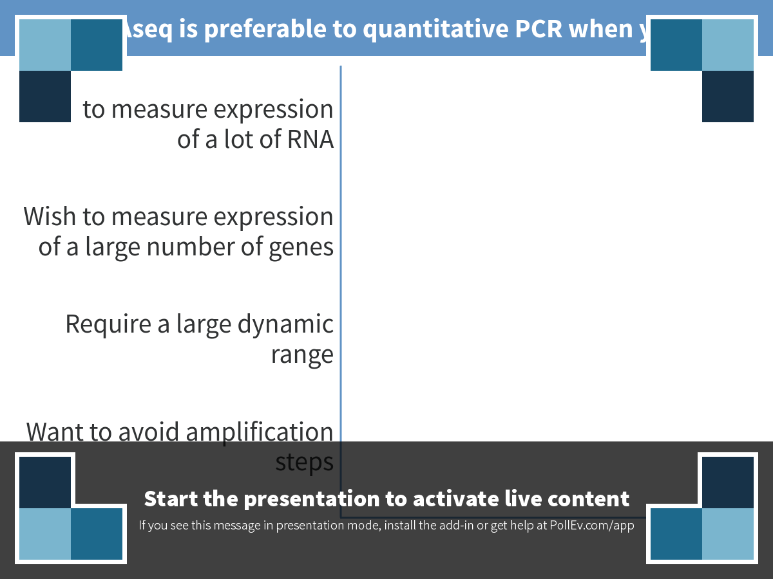
Notes:
RNAseq is preferable to quantitative PCR when you:
https://www.polleverywhere.com/multiple_choice_polls/QhXFx04s2RdqgPL

Slide 3
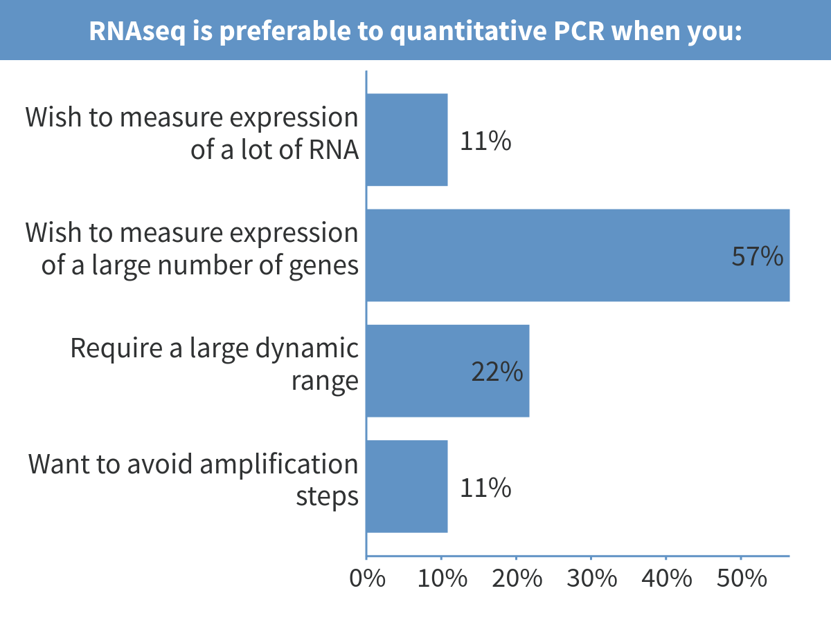
Notes:
RNAseq is preferable to quantitative PCR when you:

Slide 4
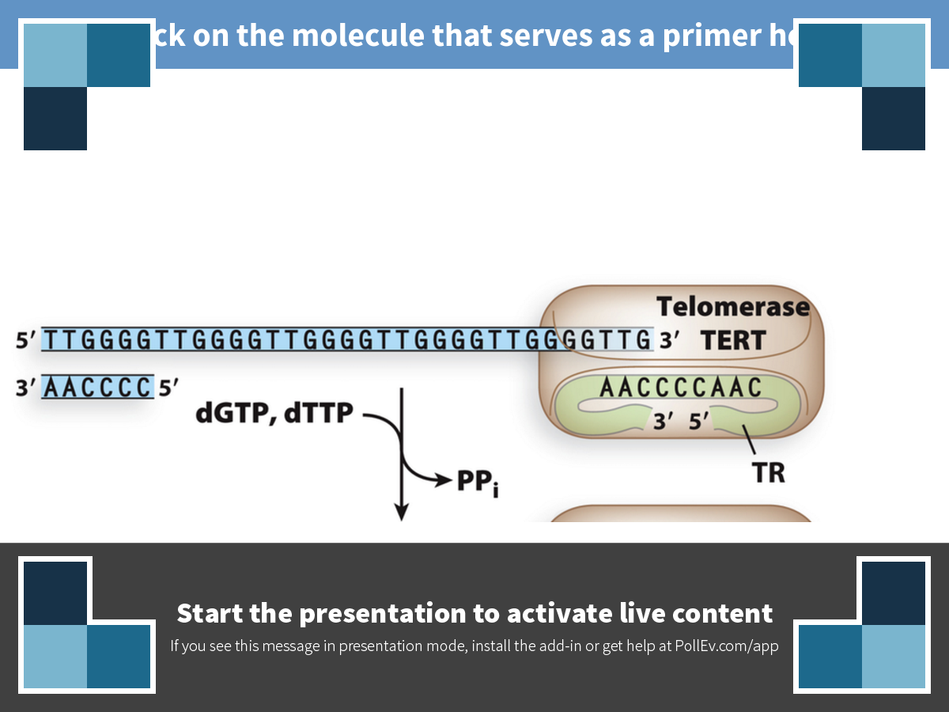
Notes:
Click on the molecule that serves as a primer here
https://www.polleverywhere.com/clickable_images/I7Ghv2VCF8Fdlyl

Slide 5
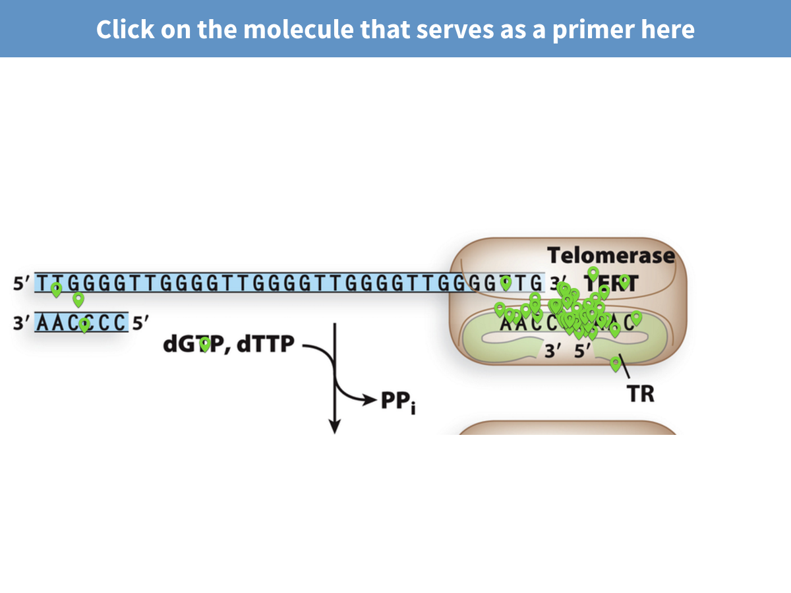
Notes:
Click on the molecule that serves as a primer here

Slide 6
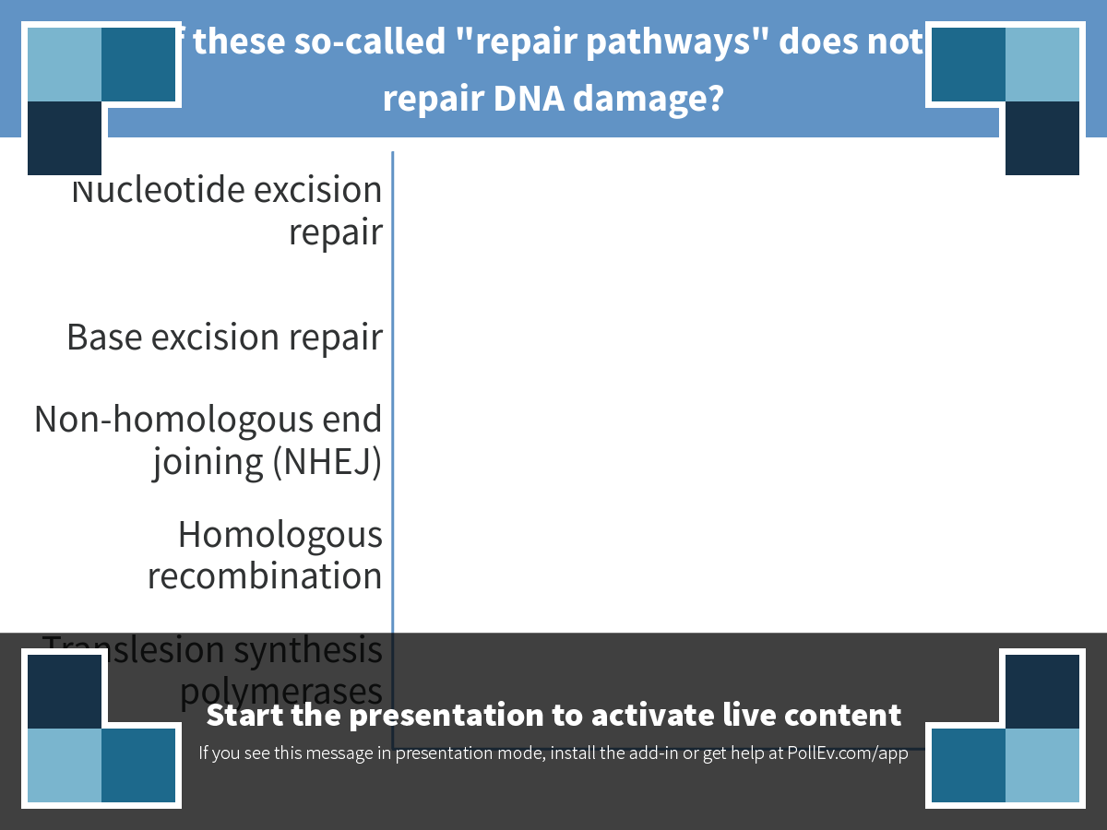
Notes:
Which of these so-called "repair pathways" does not actually repair DNA damage?
https://www.polleverywhere.com/multiple_choice_polls/MYIp3PO8nckFvvf

Slide 7
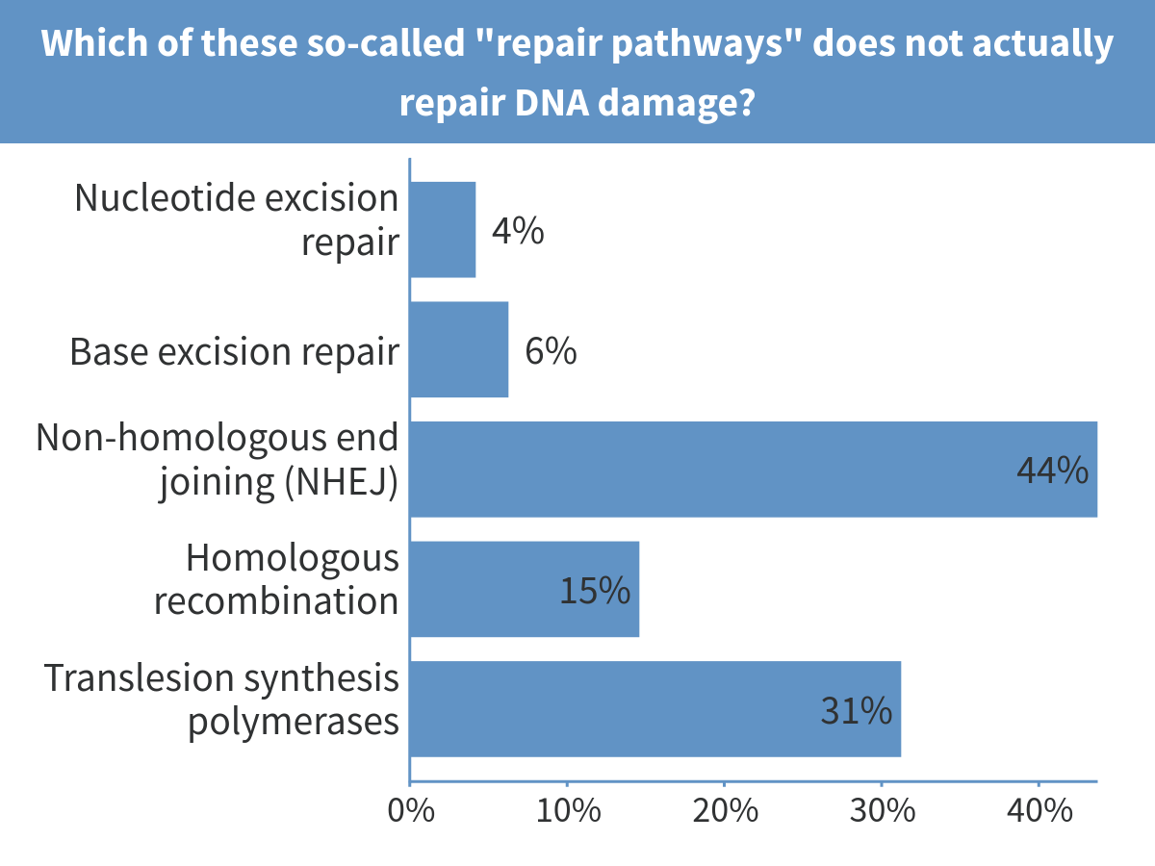
Notes:
Which of these so-called "repair pathways" does not actually repair DNA damage?

Slide 8
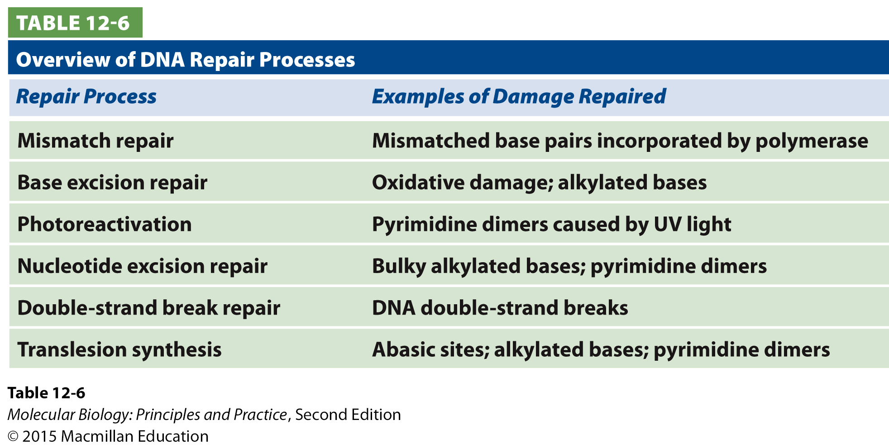
DNA repair pathways and mechanisms

Slide 9
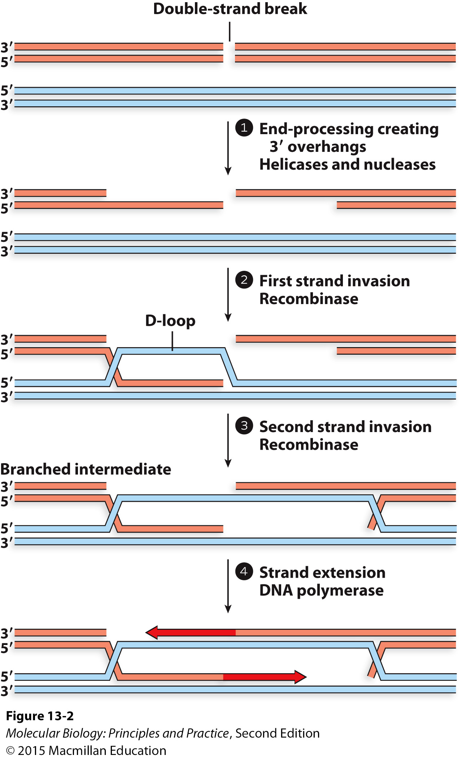
Repair of double-strand breaks by homologous recombination

Slide 10
Indicating homologous recombination with Xs
PCR product
hyg^{R}
M. smegmatis chromosome
…
rnase J
…
M. smegmatis chromosome
…
hyg^{R}
…

Slide 11
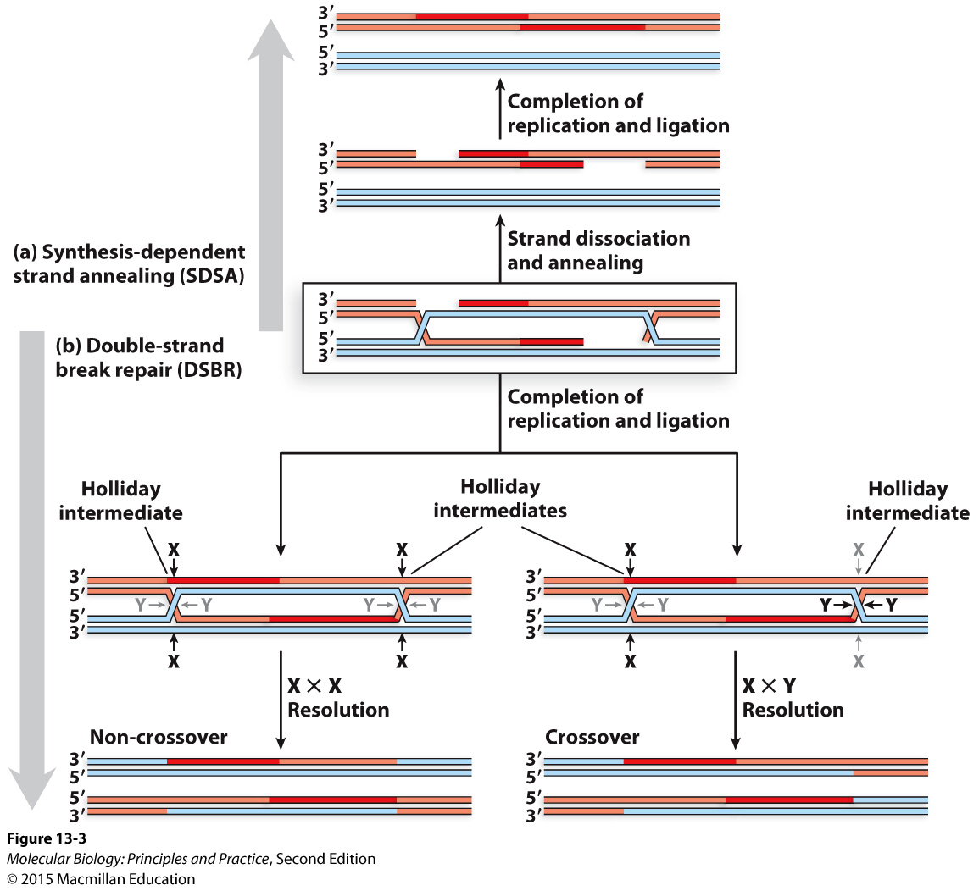

Slide 12
Homologous recombination requires a second copy of the chromosome
Notes:
Sister chromatid/replicated chromosome prior to division
Homologous chromosome

Slide 13
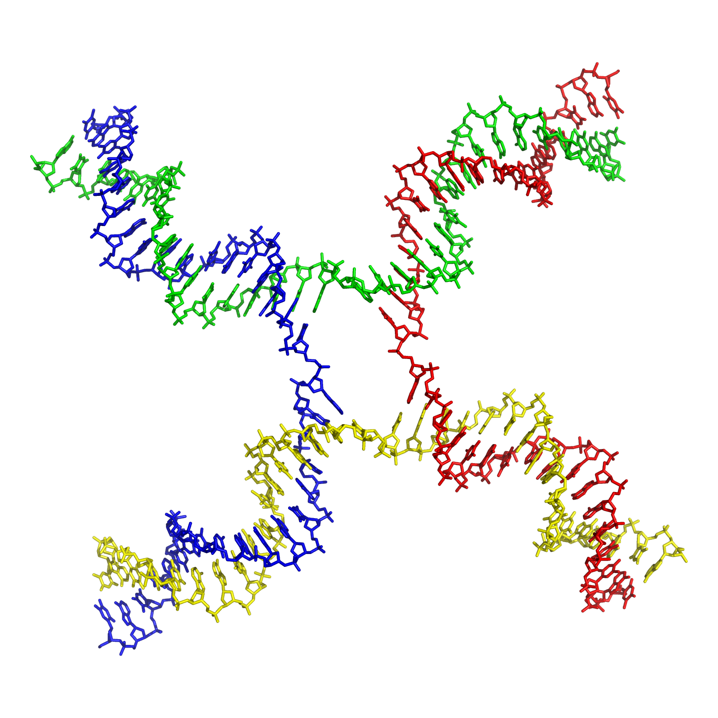
The structure of a Holliday junction (note these look symmetrical from the perspective of the resolvase)
By Richard Wheeler (Zephyris) 2007.

Slide 14
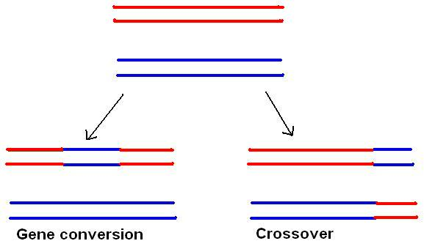
Double-strand break repair may lead to a crossover or not
By Mikael Häggström at the English language Wikipedia, CC BY-SA 3.0, https://commons.wikimedia.org/w/index.php?curid=18030437

Slide 15
Check out cute “claymation” videos on YouTube such as:
https://www.youtube.com/watch?v=3qgBKrAZCLg

Slide 16
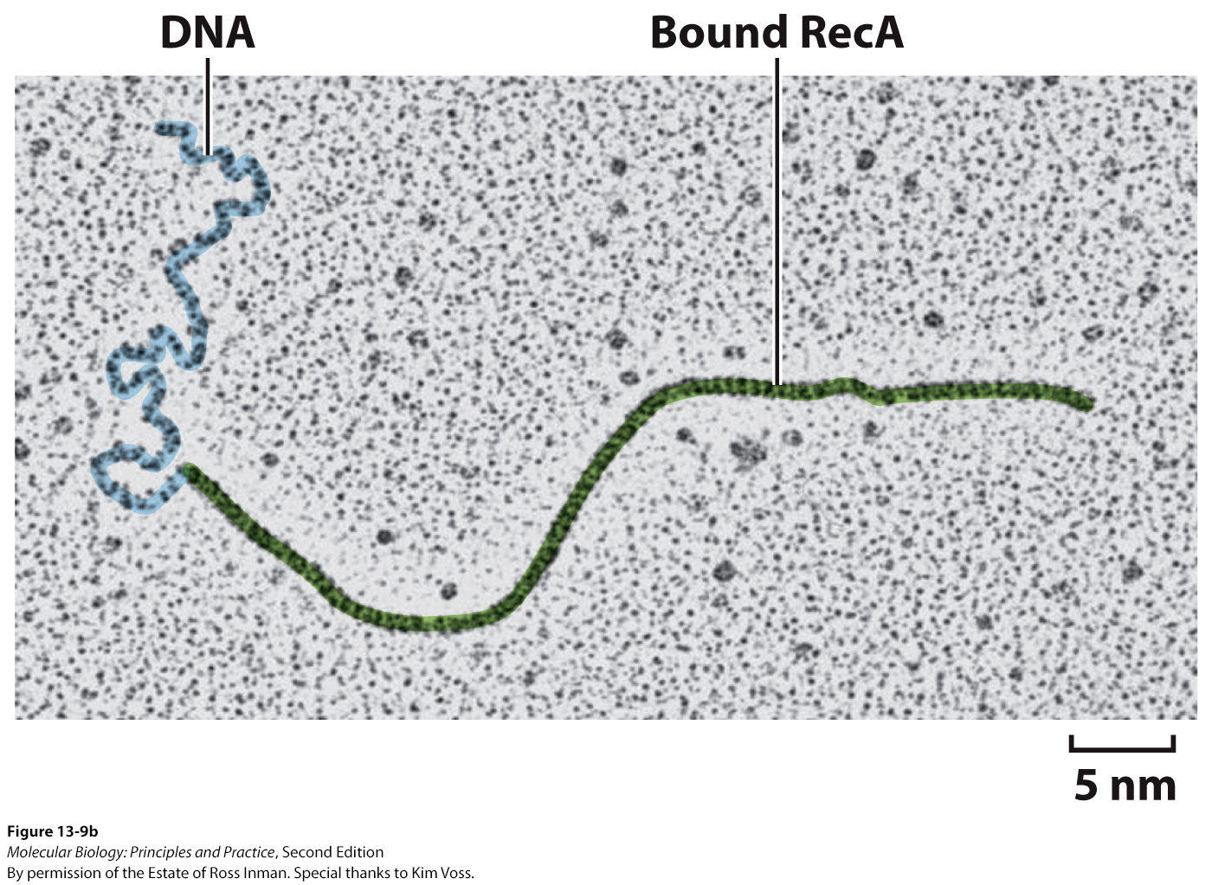
Strand invasion is promoted by recombinases coating the 3’ overhang
RecA (bacteria) or RAD51 (eukaryotes)

Slide 17
Recombination proteins to know:
The recombinases RecA (bacteria) and RAD51 (eukaryotes)
Holliday junction resolvase
Know that other proteins are required

Slide 18
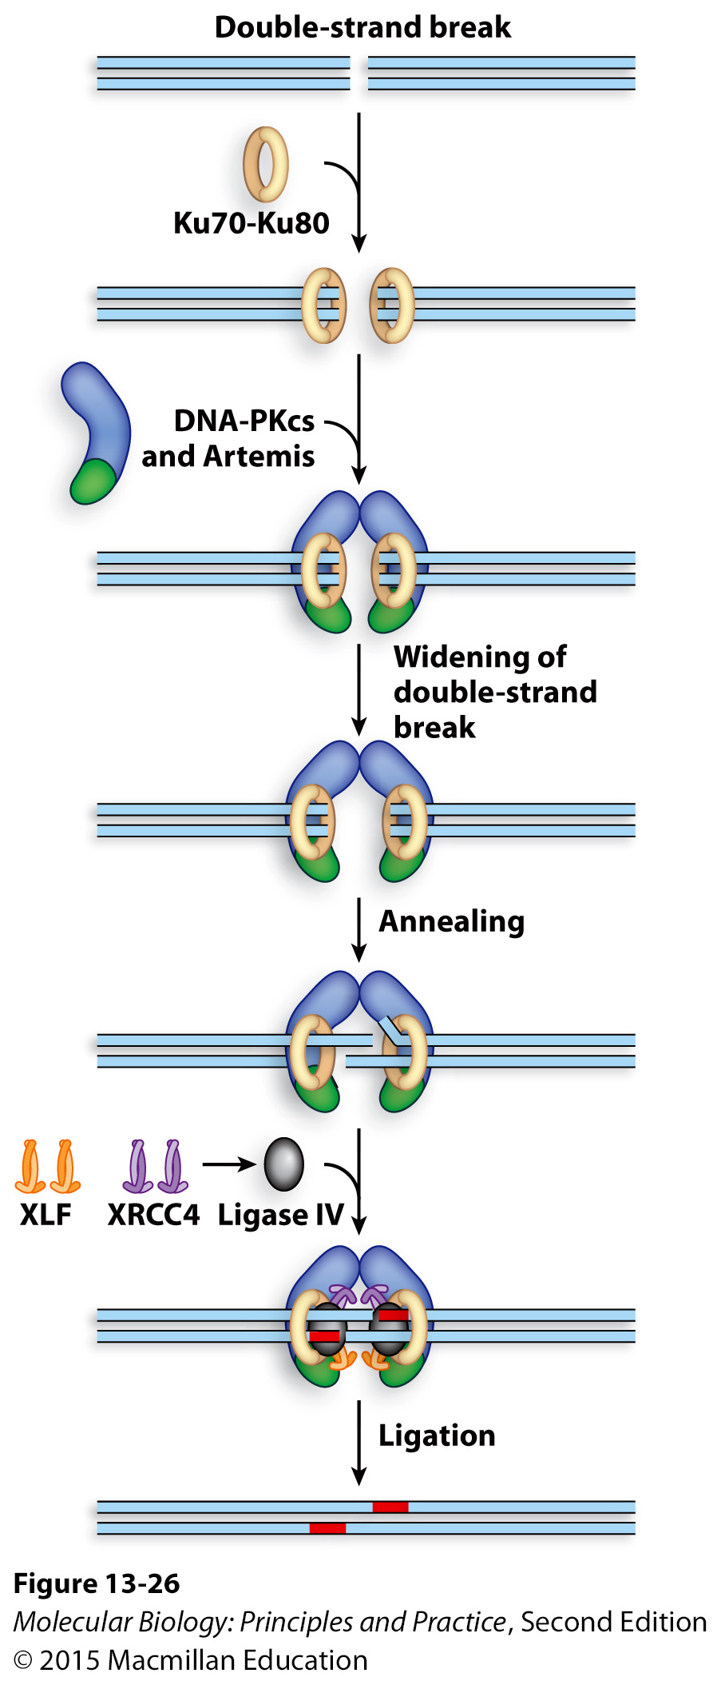
Nonhomologous end joining (NHEJ) repairs double-strand breaks with low fidelity in the absence of another copy of the chromosome
Primarily eukaryotes (although some bacteria can do it)
Common in non-replicating cells in which homologous chromosomes are not located in close physical proximity
Usually causes small deletions (mutagenic – another “desperation strategy”)

Slide 19
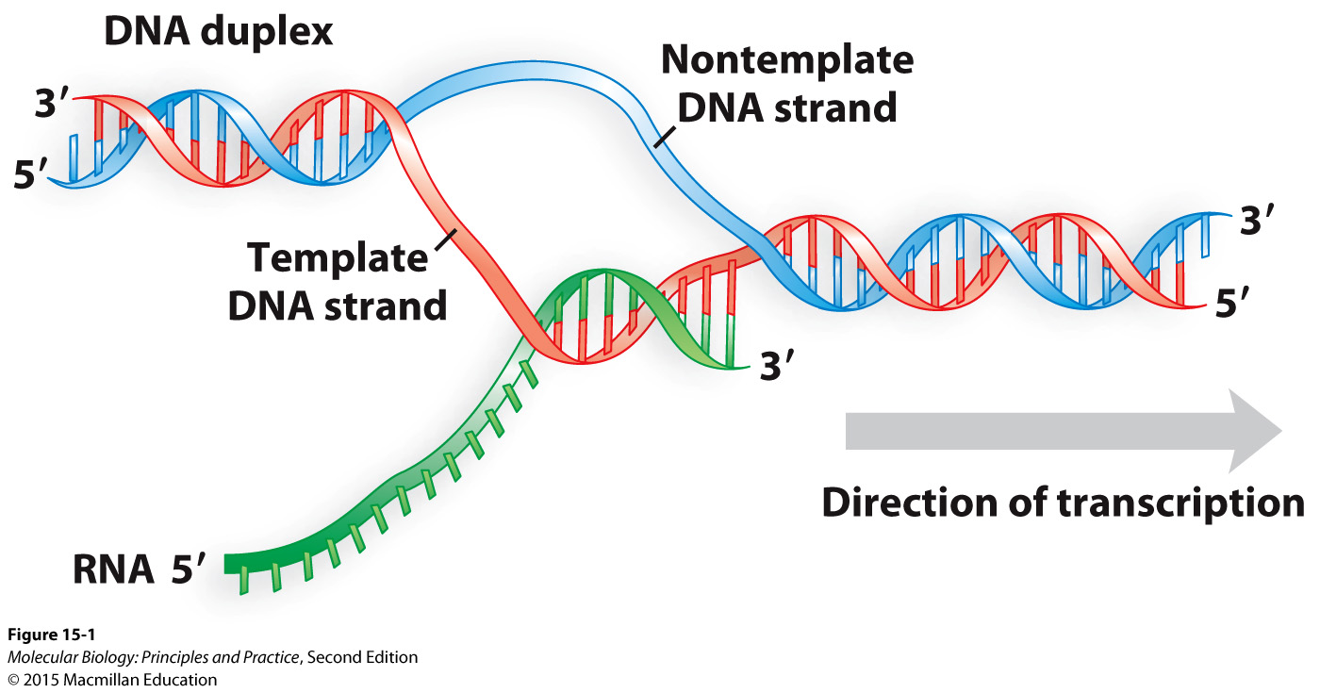
Transcription: 5’ to 3’ RNA synthesis uses the template strand to make an RNA copy of the nontemplate strand (coding strand)

Slide 20
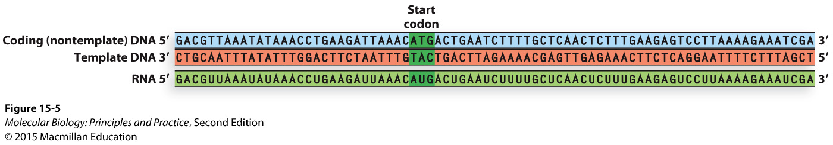
Understanding the relationship between the coding strand, the template strand, and the RNA sequence

Slide 21
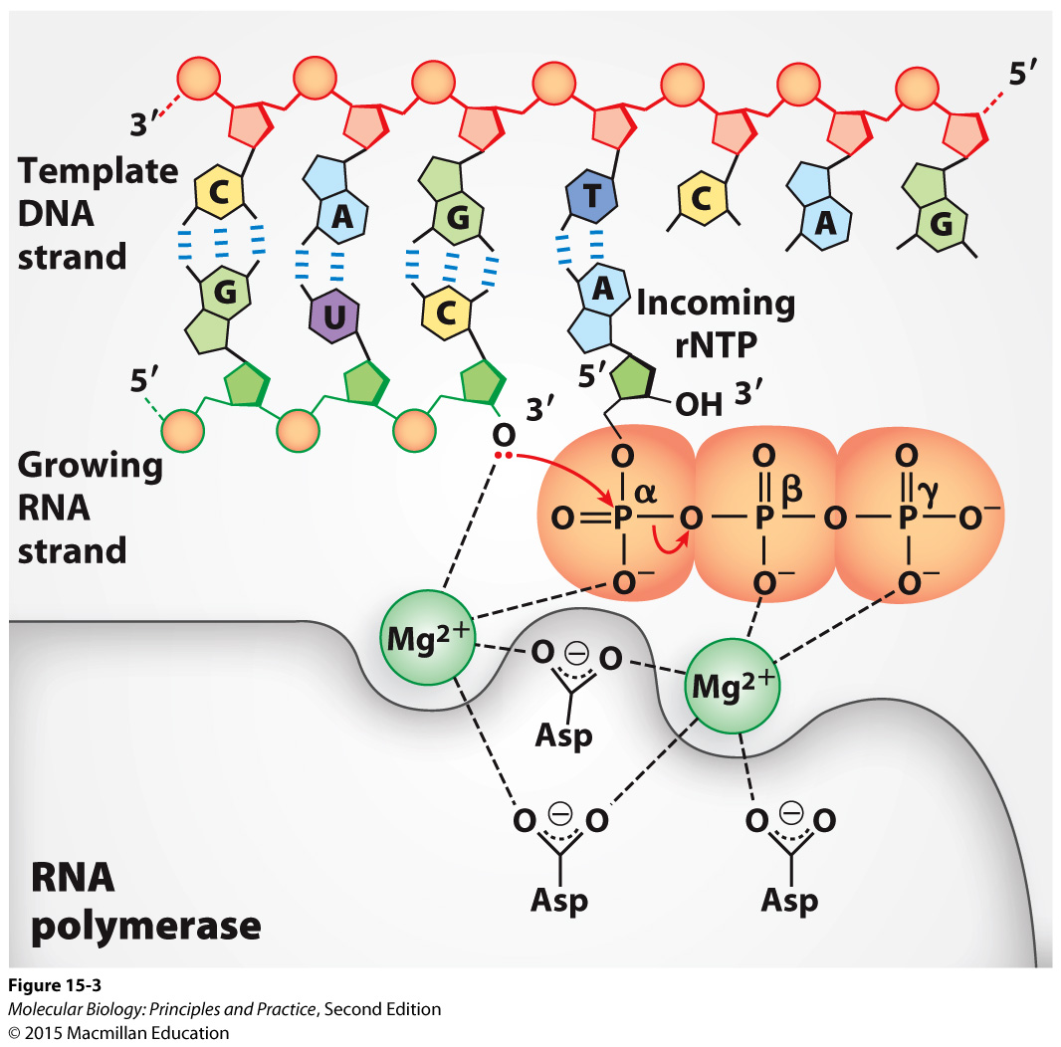
The chemistry of RNA polymerase activity

Slide 22
Some key differences between RNA polymerase and DNA polymerase
RNA polymerase does not require a helicase.
RNA polymerase does not require a sliding clamp.
RNA polymerase does not require a primer.
RNA polymerase has limited proofreading capabilities (no separate exonuclease site) and generates 2-3 orders of magnitude more misincorporation errors.

Slide 23
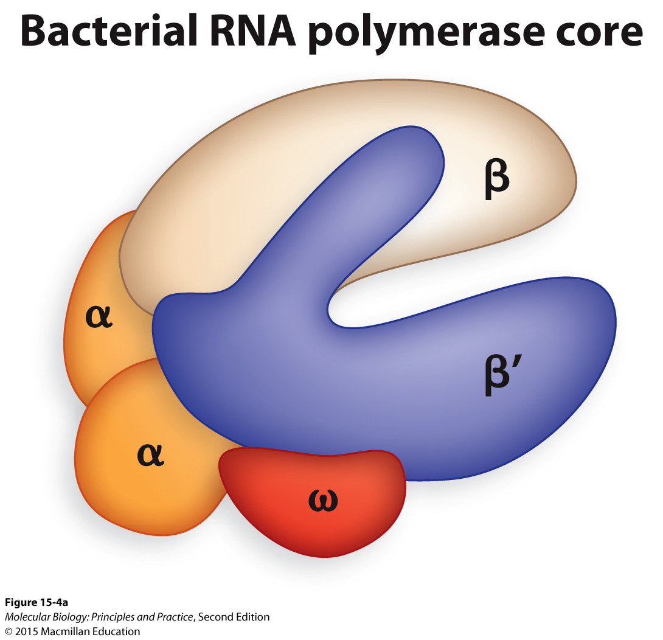
RNA polymerases are multi-subunit complexes
Notes:
Bacteria: one RNA polymerase transcribes all RNAs

Slide 24
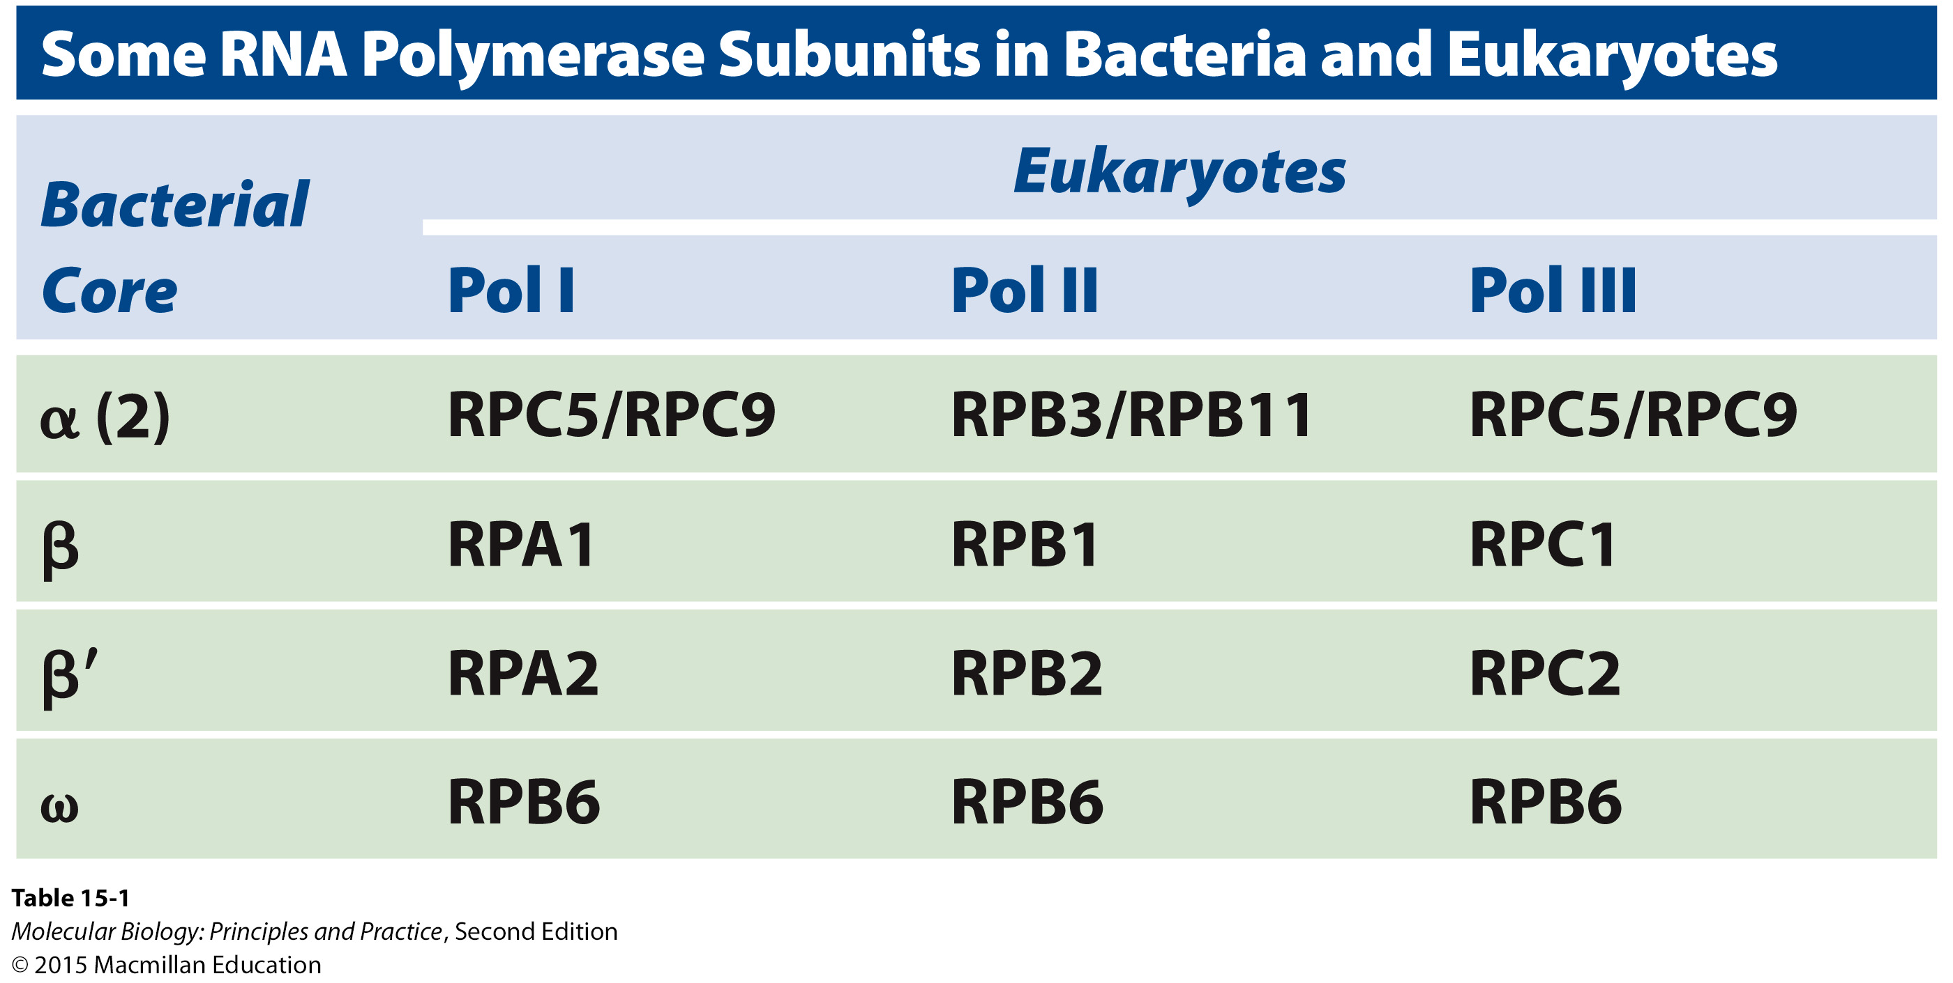
Eukaryotes use multiple RNA polymerases for transcribing different types of RNA
Notes:
Pol I: large rRNAs
Pol II: protein-coding RNAs
Pol III: tRNAs and other small RNAs

Slide 25
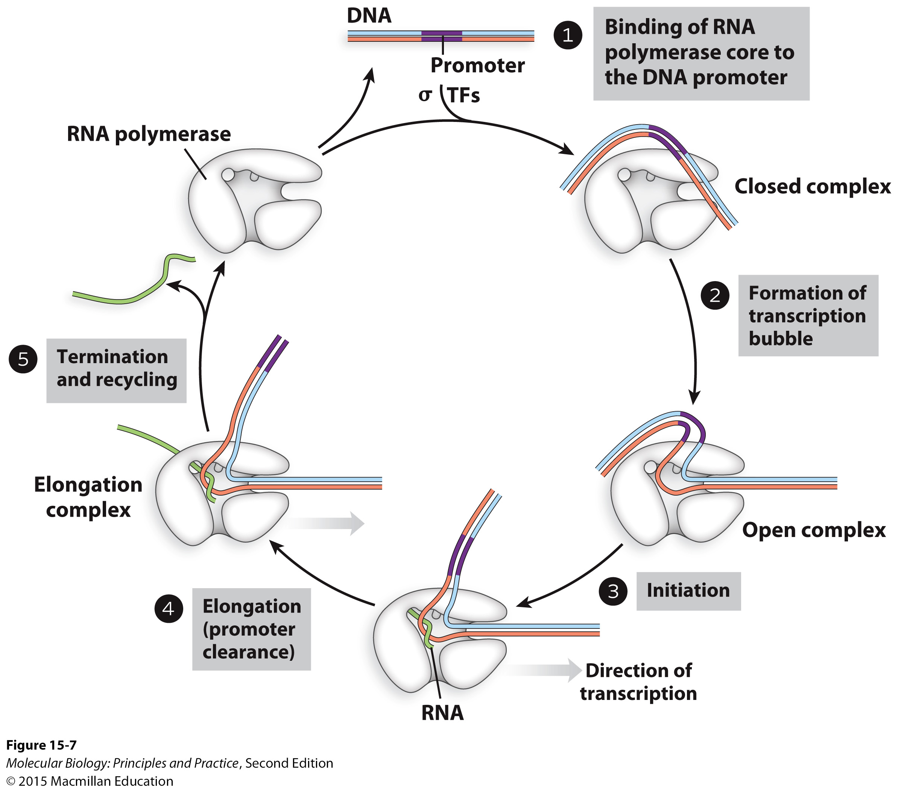
A general overview of transcription

Slide 26
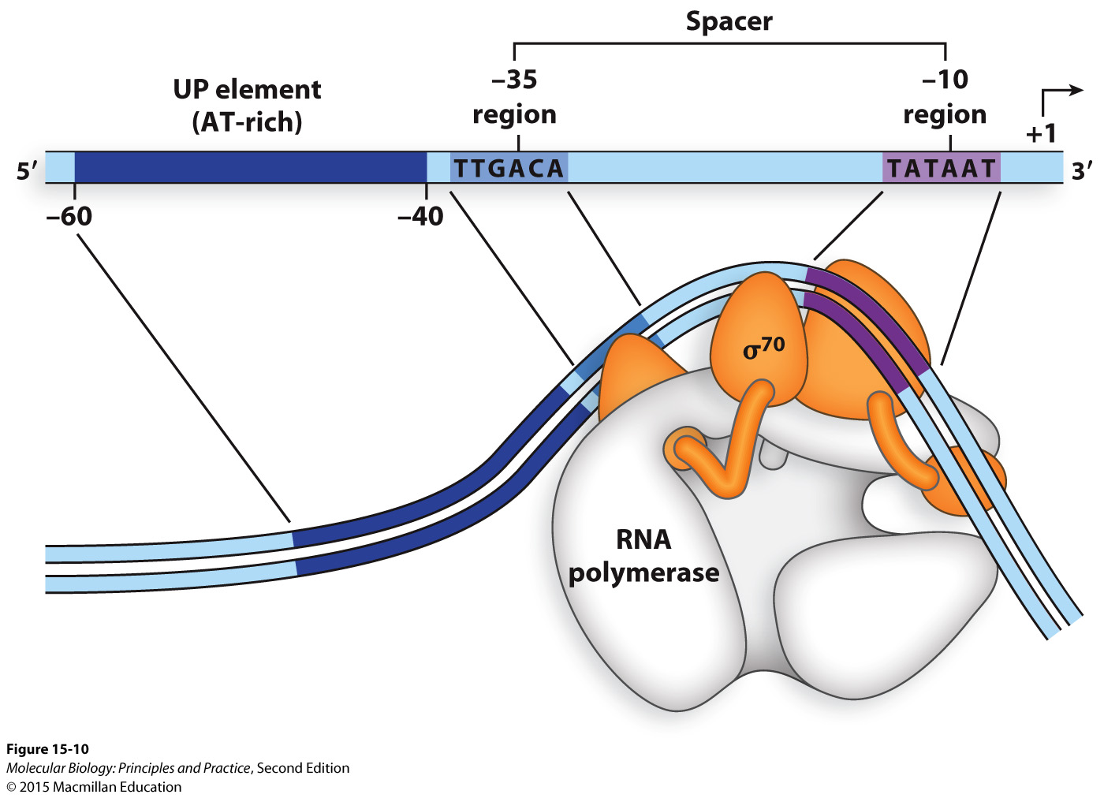
Bacterial promoters are recognized by sigma factors

Slide 27
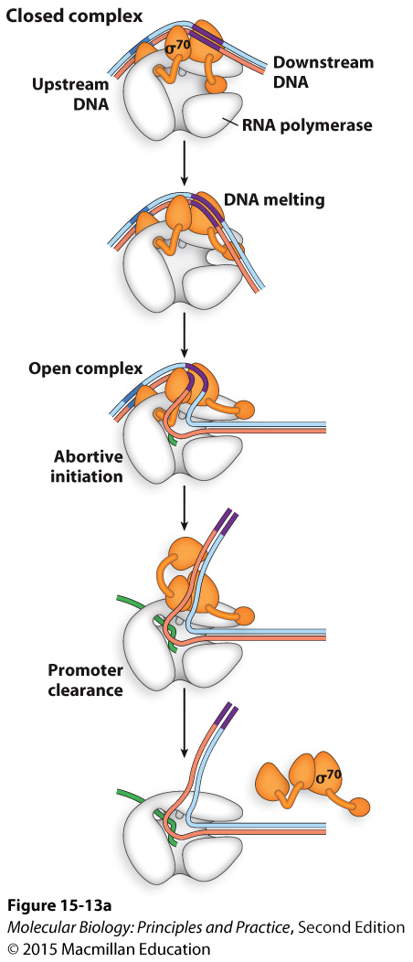
Sigma factors are required for promoter melting and initiation, dispensable for elongation

Slide 28
A “housekeeping” sigma factor mediates expression of most genes in normal growth conditions (σ⁷⁰ in E. coli)

Slide 29
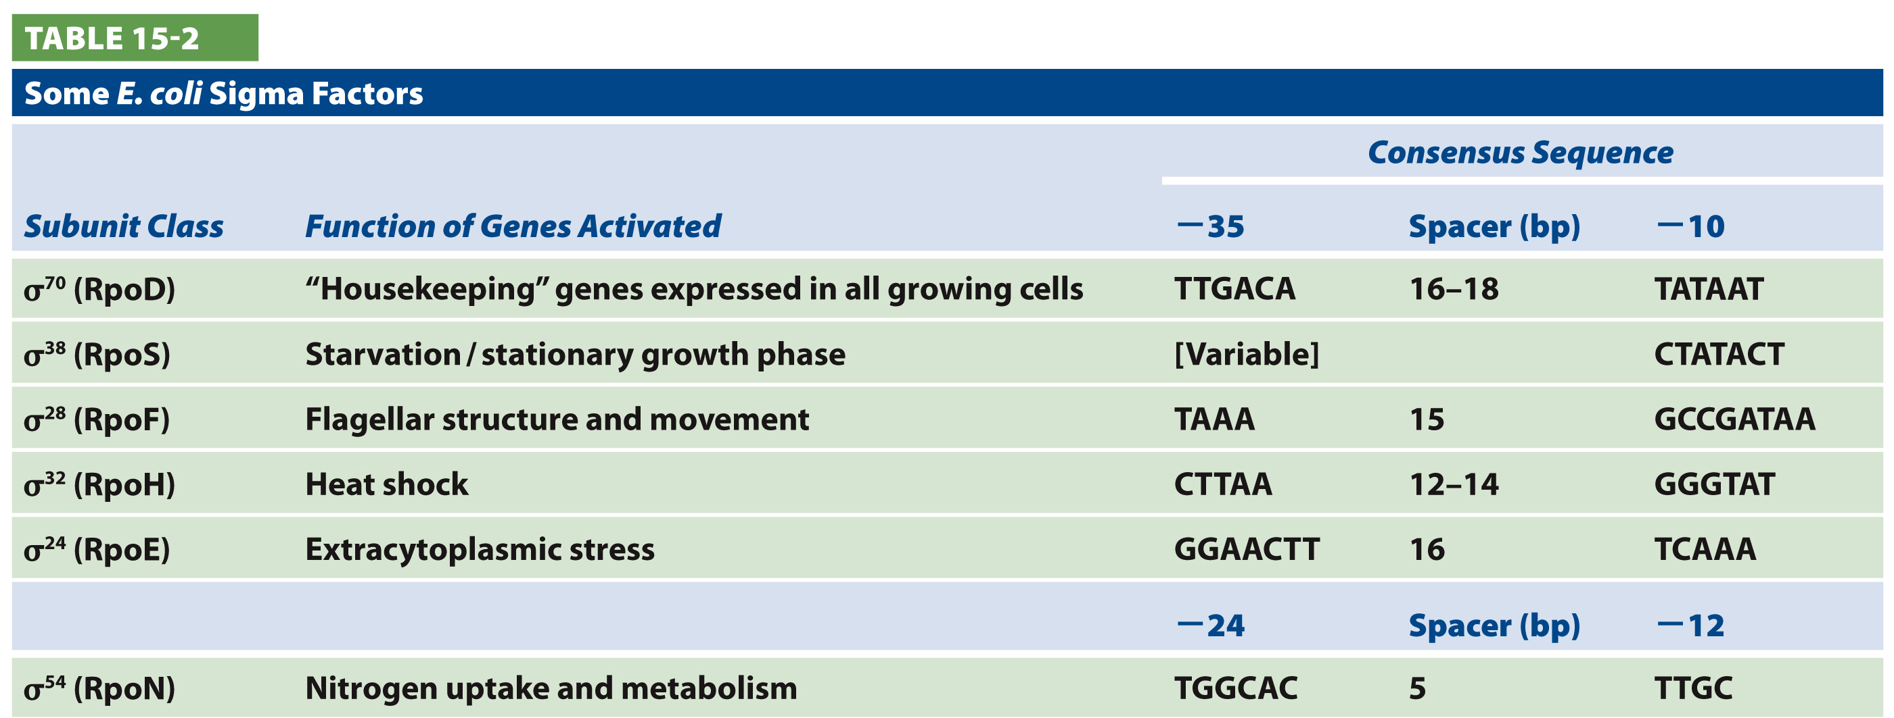
Alternative sigma factors associate with RNA polymerase core to induce expression of stress-response genes

Slide 30
Quiz 4 grade distribution
Mean: 76.18
Median: 82
Notes:
Sister chromatid/replicated chromosome prior to division
Homologous chromosome

